Slide 1
Intro to Health Data Science
MMCi Block 1
Matthew Engelhard
Notes:
Hi Everyone
I’m Matt Engelhard – I’m an assistant professor here in the Department of Biostatistics & Bioinformatics
Work in machine learning for health, particularly for mental health
I’m excited to have this opportunity to work with you.
Third year of this course; second during the pandemic
Come a long way, but getting better all the time and need your help!
I’m an MD/PhD by training – PhD in machine learning for health
I really believe that when developing this tech, it’s important to be clinically competent – I bet 4 years on it
By the same token, I believe very strongly that it’s critical that you be comfortable with machine learning – because it’s impacting the practice of medicine now, and will more and more over the course of your careers
More than anything, my goal is to tell you that these tools – they’re not different, fundamentally, from what’s come before, but are nevertheless pretty amazing

Slide 2
Introductions!
your name
+ a brief note on your background and role
+ which of the 5 topics interests you most
(intro to DS, model learning, computer vision, natural language processing, sequential data)

Slide 3
Course Overview
We will learn about state-of-the-art data science techniques that are now beginning to impact clinical practice.
How are these techniques different from what has come before?
How are they the same?
And what do you need to know to take advantage of this tech?
I know that most of you are NOT going to be data scientists.
But you will work with data scientists, and you will have to make decisions about what models to use and how to use them. It is important to know enough to get in the weeds with the data scientists, because if applied/evaluated incorrectly, these models are certain to be unhelpful and likely to be harmful.

Slide 4
A Brief Tour of DS in 2021
General Application -> Biomedical Application

Slide 5
Computer Vision: Real-Time Object Detection (& segmentation)
Notes:
Let’s take a look at the kinds of tools we’re going to be talking about – starting with computer vision
What’s happening here?
We have a system that, in real time, is recognizing … and identifying their contours
You’ve probably seen something like this on youtube – systems like this are an important component of self-driving tech (although that’s usually with lidar)
The same kind of models that can do this… can do that…

Slide 6
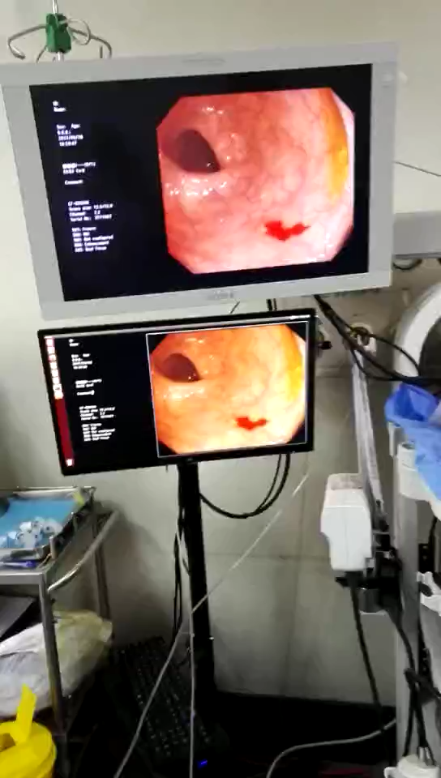
Real-time polyp detection: a second set of eyes during colonoscopy

Slide 7
Natural Language Processing: Text Generation
SYSTEM PROMPT (HUMAN-WRITTEN)
A train carriage containing controlled nuclear materials was stolen in Cincinnati today. Its whereabouts are unknown.
MODEL COMPLETION (MACHINE-WRITTEN, FIRST TRY)
The incident occurred on the downtown train line, which runs from Covington and Ashland stations.
In an email to Ohio news outlets, the U.S. Department of Energy said it is working with the Federal Railroad Administration to find the thief.
“The theft of this nuclear material will have significant negative consequences on public and environmental health, our workforce and the economy of our nation,” said Tom Hicks, the U.S. Energy Secretary, in a statement. “Our top priority is to secure the theft and ensure it doesn’t happen again.”
The stolen material was taken from the University of Cincinnati’s Research Triangle Park nuclear research site, according to a news release from Department officials.
The Nuclear Regulatory Commission did not immediately release any information.
According to the release, the U.S. Department of Energy’s Office of Nuclear Material Safety and Security is leading that team’s investigation.
“The safety of people, the environment and the nation’s nuclear stockpile is our highest priority,” Hicks said. “We will get to the bottom of this and make no excuses.
“Better Language Models and Their Implications”
2/14/19
OpenAI
Notes:
Generative models based on transformer architecture and trained on 8 million webpages

Slide 8
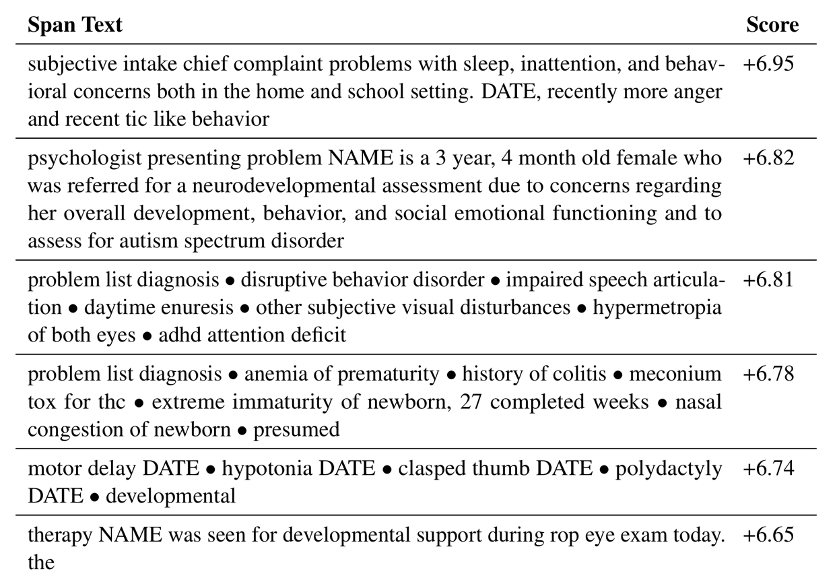
Natural Language Processing: Find Predictive Text in Notes
Passage (from note) | Change in predicted autism dx log-odds
Developmental and behavioral concerns are highly predictive
Premature birth and perinatal complications are also highly predictive
Subramanian V, Engelhard MM, Berchuck SI, Chen L, Carin L. SpanPredict: Extraction of Predictive Document Spans with Neural Attention. Submitted to NAACL.

Slide 9
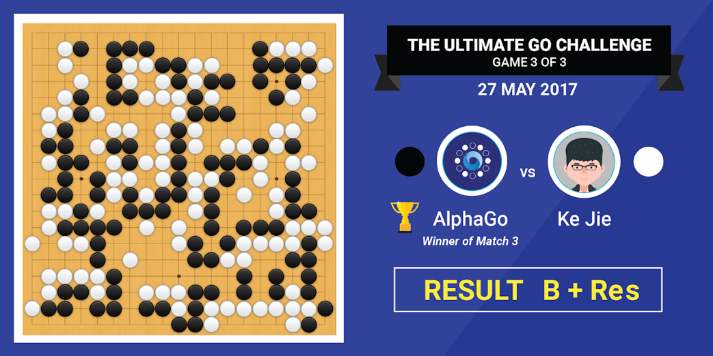
Reinforcement Learning: goal-directed sequential decision-making
Notes:
Explain what’s going on in this image
Anybody want to take a stab at how this thing might be connected to medicine?

Slide 10
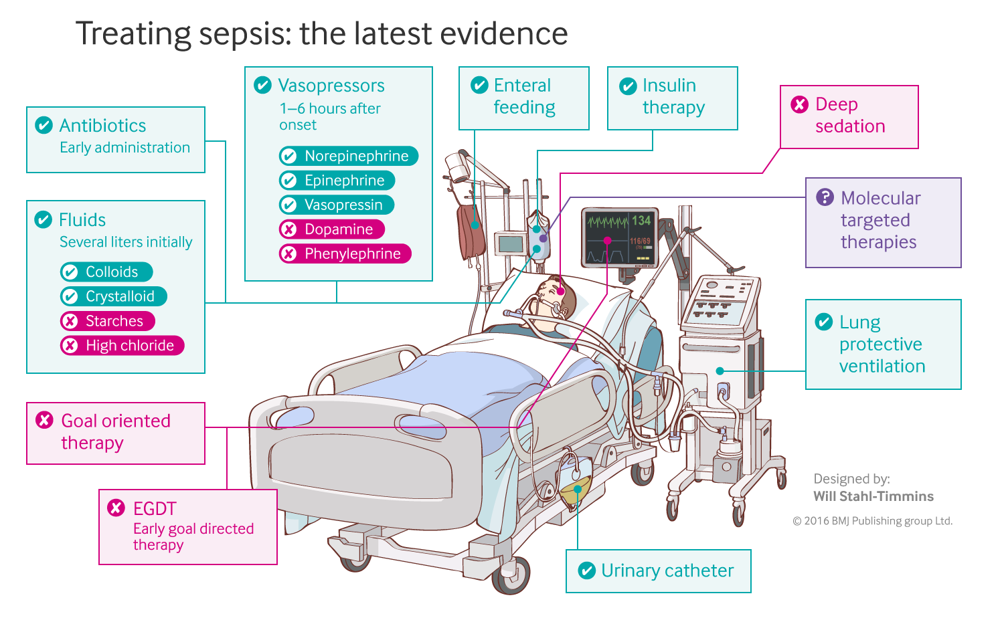
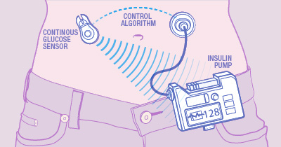
Reinforcement Learning in Medicine
Closed-loop blood glucose control
(“artificial pancreas”)
Fluid and vasopressor administration
for sepsis treatment
https://www.mayo.edu/research/labs/artificial-pancreas/overview
Gotts JE, Matthay MA. Sepsis: pathophysiology and clinical management. bmj. 2016 May 23;353(i1585).
Notes:
That same tech is helping us understand how to design an artificial pancreas that maintains normoglycemia more effectively than a person can
And can help us optimize certain types of sequential decision-making problems, such as fluid and vasopressor administration in sepsis management

Slide 11
The Current DS Moment
Looking back to 2012…

Slide 12
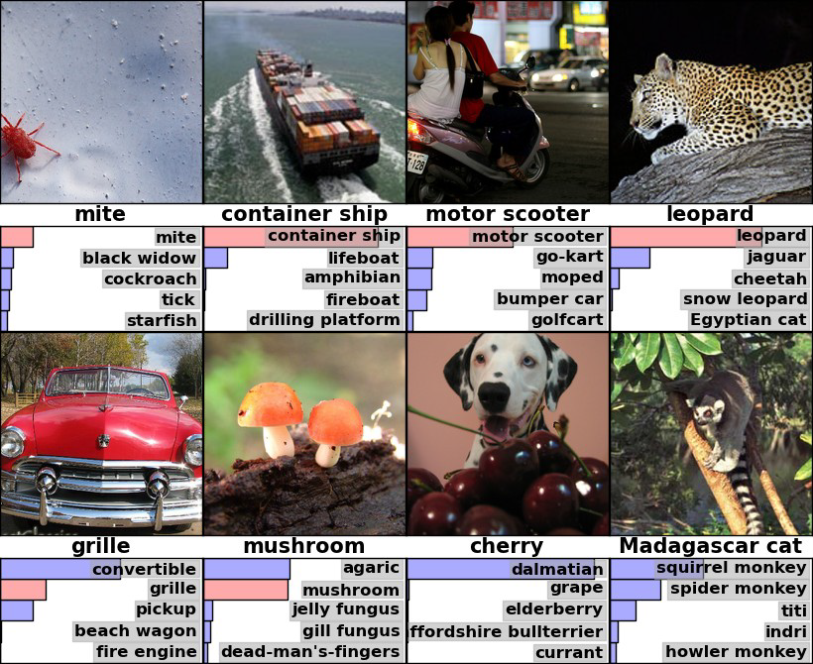
Deep learning leapt forward in ‘12 and beat humans in ‘15
Figure from Krizhevsky et al 2012
Notes:
Let’s go back to 2012.
At that time, it was all about the support vector machine – neural networks were on the fringe.
The techniques to train them had been around for a while, but other approaches were better, and easier. Very few were using them.
Describe ImageNet challenge
Want to recognize what is in an image (1 of 1000 categories)
Have ~1 million example images
Very relevant for things such as image search
Example images are shown on the right, with predicted categories beneath each image
In 2012, we had Alexnet – huge leap forward in performance on this task, and it was using a deep NN.
They had figured out the right architectures, but more than that they started using LOTS of data.
Deep learning – a rebranding of neural networks
Machine learning goes beyond neural network approaches, but currently they are dominant

Slide 13
Deep Learning now surpasses humans in a variety of tasks
Notes:
Famously, Google DeepMind trained “AlphaGo” to beat the world champion Go player (a complex game)
AlphaGo uses Deep Reinforcement Learning (learned by repeatedly playing the game), to be covered in block 4
Many other examples:
Voice Recognition
Object Detection
Text Translation
Etc.

Slide 14
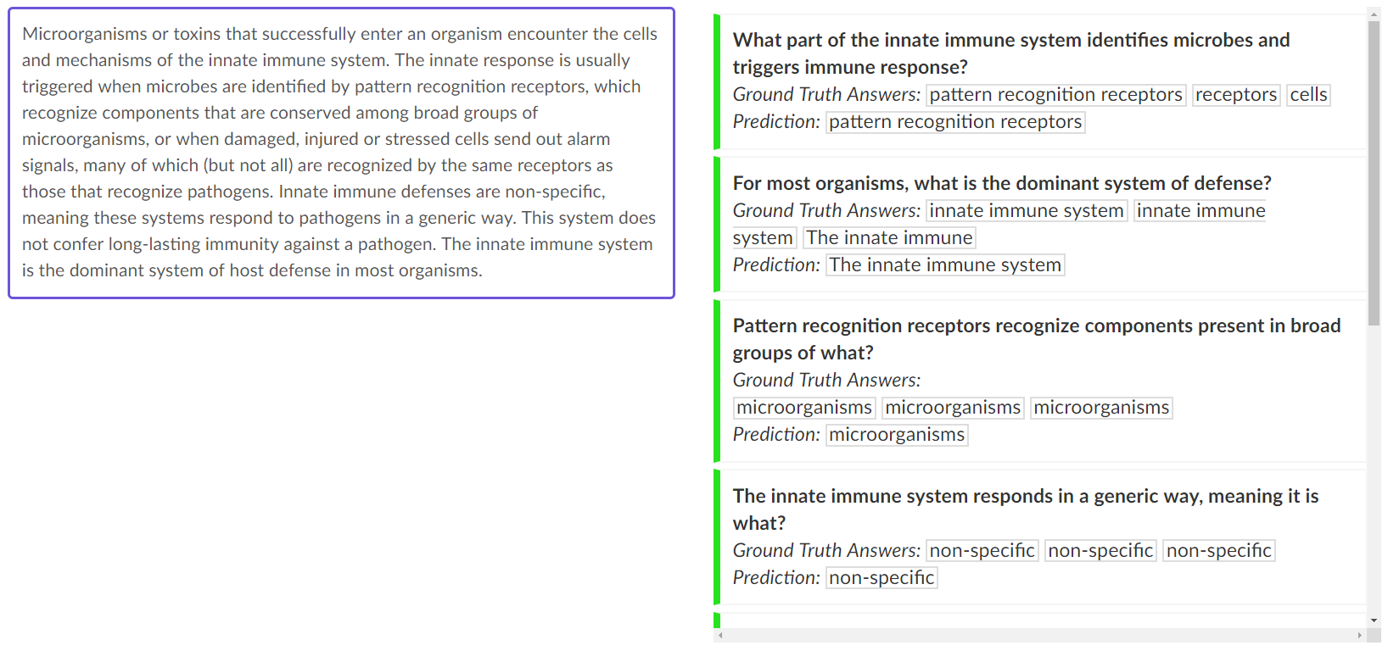
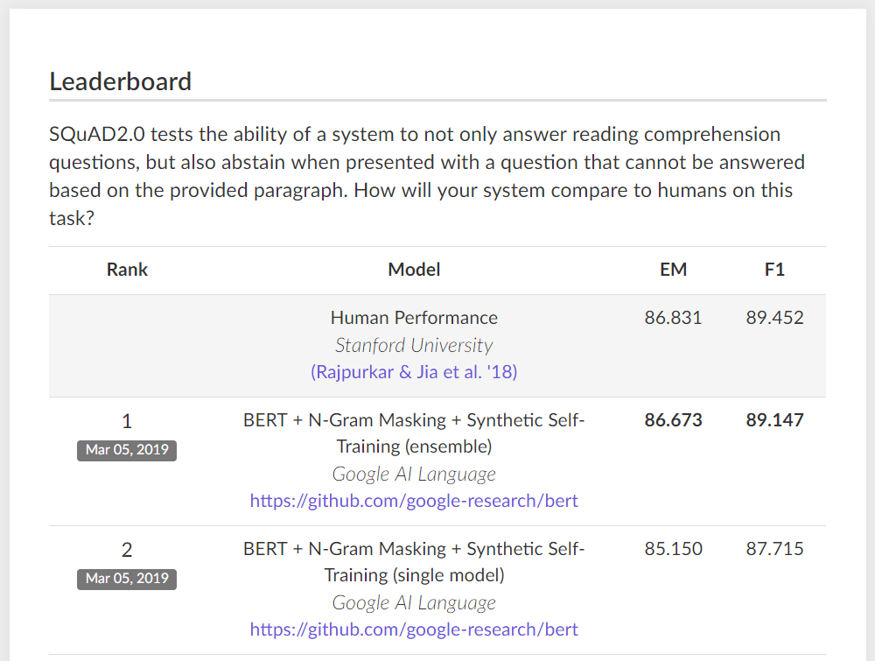
Most recently, DL has surpassed humans in language tasks
Notes:
SQuAD 2.0 developed in 2016
Paragraphs of content along with questions about that content
Here we have paragraph about the immune system along with relevant questions that can be answered. But again, not all of these questions can be answered, and it is important for the system to recognize this.
Exact match. This metric measures the percentage of predictions that match any one of the ground truth answers exactly.
(Macro-averaged) F1 score. This metric measures the average overlap between the prediction and ground truth answer. We treat the prediction and ground truth as bags of tokens, and compute their F1. We take the maximum F1 over all of the ground truth answers for a given question, and then average over all of the questions

Slide 15
All of these have, at their core, a predictive model
y, associated value or label
x, data/features for a subject or patient
End goal: predict y from x
Notes:
But at the heart of all of this is the predictive model.
In almost all the cases you just saw, we have a machine – a computer program, really -- that takes some data, let’s say x – processes it in some way -- and then makes a prediction about some associated value y -- its prediction is informed by the data x
The thing that accepts x and spits out y – that’s the machine in machine learning.
The machine could be a computer, a person with a calculator, whatever
But whatever it is, it needs to learn how the x’s relate to the y’s so it can make the best predictions possible. We’ll talk a little more about what that means toward the end of the lecture.

Slide 16
Simple models often work well for clinical data!
WBC Count
Respiratory Rate
Creatinine
Mean BP
Hematocrit
Pulse Rate
Temperature
Survival
Age
y, associated value or label
x, data/features for a subject or patient
End goal: predict odds of hospital mortality
Notes:
In medicine, often x is a fairly simple set of features
Models that deal effectively with highly complex data, like images – those are fairly new
But predictive models are NOT new, AT ALL, in medicine
Think cardiology, Framingham, pooled cohort equations, etc
We have APACHE III, for instance – APACHE stands for ACUTE PHYSIOLOGY AND CHRONIC HEALTH EVALUATION
This is a predictive model that takes a limited set of clinical variables, collected on ICU admission, and makes a mortality prediction

Slide 17
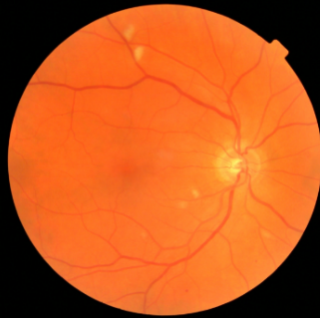
For complex data, more complex models are needed.
y, referrable diabetic retinopathy
x, retinal image
End goal: predict y from x
Notes:
I said before that those examples above, they all have a predictive model at their core
Let’s look at each in turn
In computer vision, the simplest case is that we have an image – that’s the x – and we want to make a prediction
Ones that have been studied:
Identify referable diabetic retinopathy
Identify abnormal proliferation of blood vessels
Identify Alzheimer’s disease?
At this point, a couple of important asides.
First, NONE of this is causal. The fact that a retinal image can be used to predict the presence / absence of Alzheimers does not mean that something about the retina is causing Alzheimers. Obvious in this case, but important to remember that in general, prediction doesn’t imply anything about causation.
Second, prediction isn’t saying anything about the future. We’re just making a guess about some value associated with the image.
Third, there’s clinical intuition and knowledge that comes into play at many steps along the way to developing a model like this. But the first one – have to decide whether the task is even reasonable… is it reasonable to think that…

Slide 18
Course Objective
Understand of the capabilities and limitations of healthcare data science well enough to:
design and manage data science research and/or QA/QI projects
collaborate and communicate effectively with data scientists
critically evaluate data science models and methods, with an emphasis on rigorous model validation
Notes:
Note that we’re focused on collaboration, etc.
Also note that we are going to jump right in and talk about models
Then we will pull back a little

Slide 19
Course Requirements and Materials
Let’s take a look at the website
Questions & discussion about course requirements, materials, or activities
Contact me: m.engelhard@duke.edu
Notes:
Note that we’re focused on collaboration, etc.
Also note that we are going to jump right in and talk about models
Then we will pull back a little

